Slide 1
Getting the Most out of your Stress Reduction
Sue Wimmer, MS OTR/L
Occupational Therapist
Polk. Linn and Marion county EASA

Slide 2
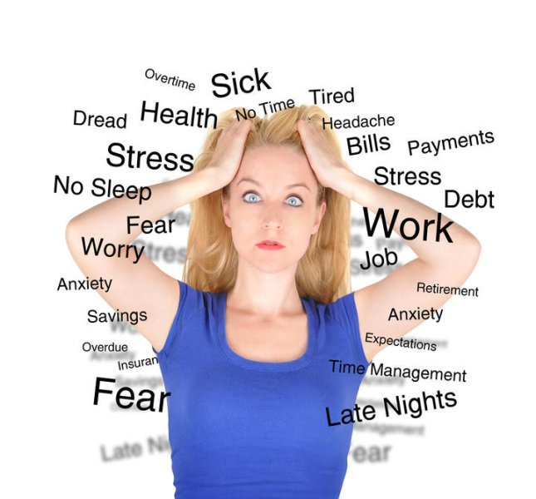
Stress
Notes:
Ask about the effects of stress on our lives and bodies

Slide 3
Stress
Every day our bodies are bombarded by stress.
Some stress is good and helps us to learn, be creative and survival.
“Good Stress” keeps us alert and on our toes to paying attention, using our thinking brains, be creative and looking at options.
There is a point where good stress becomes too much and we become overwhelmed and stressed.

Slide 4
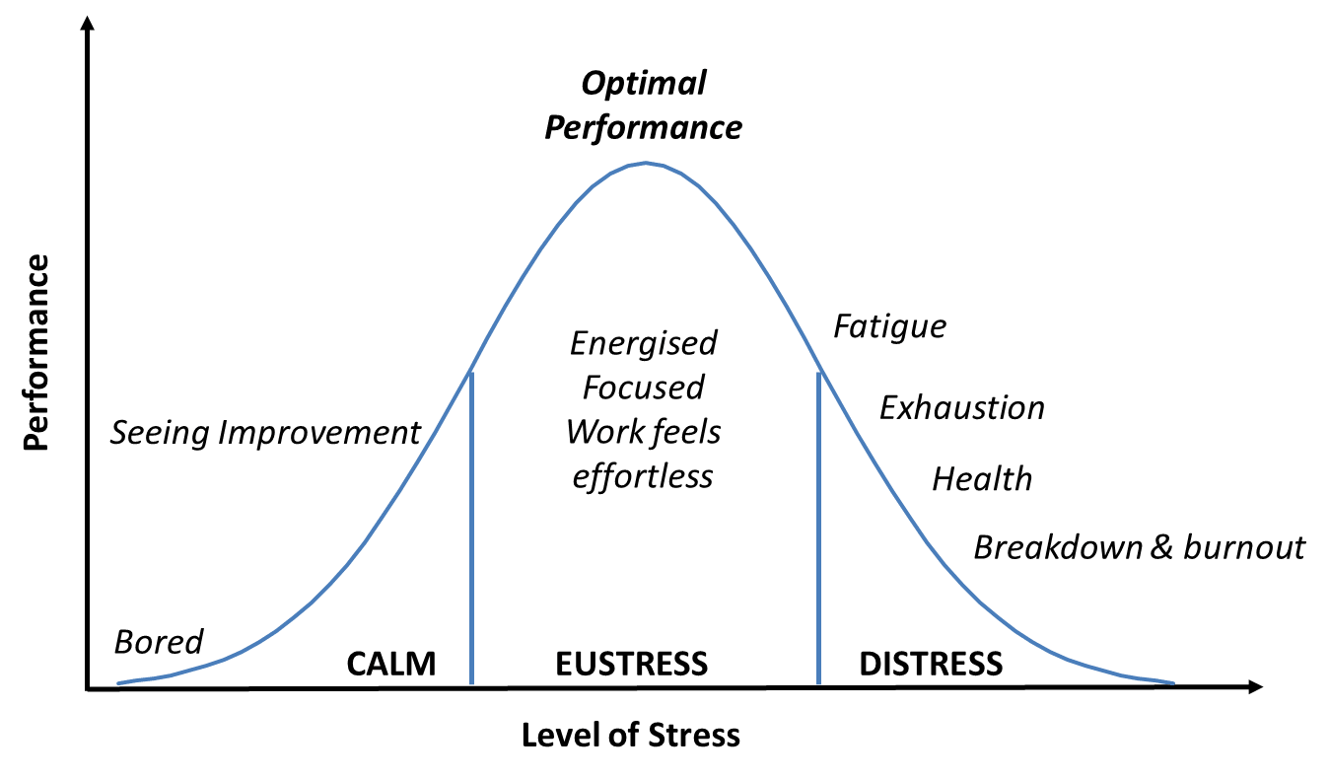
Levels of Stress

Slide 5
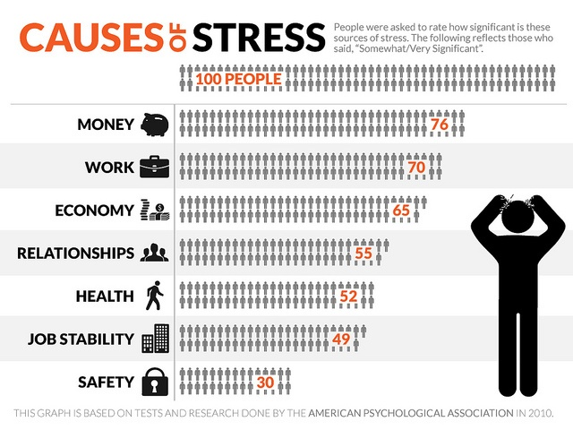
Stress
Stress in our lives:
Notes:
All bombarded with stress
Parents
Youth
Professionals
You as a person

Slide 6
Stress
Today are lives are always “on”
Technology- social media
We don’t slow down
Working harder
Don’t get away on vacations
“New norm”
Over worked
All around us – noise, smells, movement, etc.

Slide 7
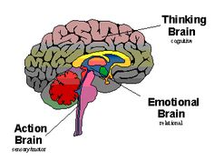
Stress
We function with 3 brains:
Survival/Action
Emotional
Thinking
Notes:
Action/survival = unconscuous beh responses
Limbic/emot- consc and unconsc, reation learnied in the past +/- emotional trigger
Thinking brain- cortex = consc and self talk

Slide 8
Stress
Our survival/action brain in the lowest and the most primitive.
It responds to stimuli from environments and usually reactions occur without thinking. These are reflexive or built in for safety and survival.
If we see a bear, our bodies automatically go into fight or flight:
Our eyes widen to take in more information
The blood goes to our muscles for fuel to run
Our heart beat speeds up to get more blood to the body
Our breathing increases to get more oxygen in and carbon dioxide out

Slide 9
Stress
These are natural reactions to help us to keep safe.
If we have to fight or run we are better prepared
These interactions occur at a basic neurological level and do not ever reach the level of thinking brain until seconds later. They are unconscious reactions/responses
These are activated by fear or discomfort

Slide 10
Survival brain
Key to survival and basic functioning
Our survival brain also helps to regulate our hunger, respiration, elimination, circulation and other body functions.
It also regulates our alert and calm states
It uses sensory input to know how to react and respond
Brain stem and cerebellum

Slide 11
Limbic brain
The next brain is the limbic or emotional brain
Our emotional brain helps us to put feelings to our experiences
Our limbic brain is activated by love or fear
It helps us to make connections with others
It interacts with others within the first 10 seconds of seeing them. That sets the tone of the interaction for the next 6-8 hours.
If we see someone who evokes fear in us then we will move back down into the survival brain

Slide 12
Thinking Brain
The highest level of the brain, is the thinking brain
It provides us with problem solving, analysis, connections, compassion, curiosity, creativity and joy.
When we are in this brain we can come up with alternative solutions, new ideas to try and are able to work things out.
We are able to self regulate ourselves and our emotions, do planning and problem solve without drama.

Slide 13
Stress
Whenever we get into a situation where our stress response is activated then we go back to our survival brain and not our thinking brain. We become self centered, whine, blame, complain, and lose our problem solving.
We become very focused on our self preservation whether physical or emotional.

Slide 14
Stress
Sensory input comes in and is analyzed as:
A). Something that is a threat to us
B). Something, probably new that we need to pay attention to
C). Something that we have experienced before and we do not need to pay attention to and never reaches the level of the thinking brain.
Notes:
Toes in our shoes – wrinkle is socks or rock in shoe

Slide 15
Stress
If it is something we need to pay attention to or threatens us, our survival brain is activated and stress hormones flood the bloodstream.
The nervous system is alerted and the mechanisms go to work:
Eyes open
Muscles prepare
Heart rate raise
Breathing increases
Digestion stops
Notes:
Hold our breathe- within 8 seconds go into fight or flight

Slide 16
Stress
We either fight to protect ourselves
Or
Flee – run away
Or
If the stress is too much we can “freeze.” We curl up in a ball and pretend we are dead.
You also cannot “over ride” this reaction with your thinking brain once you are in this state.

Slide 17
Stress
Fight or flight, helps to burn off the chemicals that are in your system and bring your nervous system back to a pre-stress state.
In the past this physical activity would be a healthy way to get back to a pre-stress state and clear the hormones out of our system.
Today our stresses are not physical and we do not get the chance to burn off our stress.
Traffic jams, deadlines, expectations, arguments, etc.
So we need to learn new ways to burn off the stress.
Notes:
Taffic jams etc= don’t burn off stress

Slide 18
Stress
You can become stressed by other things, such as being hungry, tired or sleep deprived.
You cannot think, listen or learn if in biological stress.
Brain also needs glucose, water and oxygen and if it does not get it, it won’t work.
If the body is stressed it sends the glucose from the brain to the gut to make fuel to run rather than think.
Notes:
If brain does not have enough oxygen, water or glucose will go into survival brain to be sure it gets it

Slide 19
Stress
In order to overcome the stress response, you need to use your body and nervous system to calm yourself
You can tell yourself to calm down, but does not work, have to use the nervous system to calm
You need to go back to the survival brain, to calm it
Notes:
Stim comes in and surv brain alerted – all ready too late to use thinking strategies. If can feeling early may be able to block

Slide 20
Biological stress break

Slide 21
Stress reduction
Breathing is # 1 way to calm self
Within 90 seconds you can calm your system and get out of fight and flight- if done right!
You need to access all lobes of the lungs and the Vagus nerve to turn off the stress response= belly breathing
By accessing the lower lobes of the lungs you trigger the calming messages and they get spread throughout the body
Notes:
What state do you need to be in to start deep breathing?
In fi & fl have shallow, fast breathing for getting away
We are often in survival mode & not aware of it

Slide 22
Belly Breathing
Need to see belly move
Best to do lying down
Lots of ways to learn
4X4
4 in-2 hold-6 out
You Tube
Apps: deep breathing, relaxation, belly breathing
Virtual Hope Box- free, lots of things to use
Breathe2relax- lots of instruction and talks about stress
RelaxDeepBreathe –
Relax Lite- meditation and breathing

Slide 23
Other ways to use breathing
Help to go to sleep, 6-7 deep breaths when get in bed
First thing in the morning to get blood flowing
When in a stressful situation – late, get yelled at, have an argument, stuck in traffic, nothing is working right
In a surprise situation, take 2 deep breaths before say anything
Others reflect your breathing, so if you are calm and breathing slowly will keep them calm also.

Slide 24
Movement
Move to relax
Proprioception =heavy work with the joints and muscles
Walk = bilateral brain functioning and breathing
Stretching
Rhythmic exercises- running, walking, swimming, rowing,
Yoga/TaiChi – moving and stationary, breathing, flexibility, stretching, strength and balance
Massage
Dance –with music and a partner
Notes:
Use both sides of body
Use heavy work – joints & muscles
Rhythm
Stretching
Bring to center

Slide 25
Music
Many components to music:
Tempo
Tone
Rhythm
Harmonies
Melody
Effects many areas of the brain
Two parts to music; hearing/action
Can effect the heart rate, breathing, brain waves

Slide 26
Music
Rise with music
Sing with music
Instrumental music
Mantra
Move with music
Use music
Music is very individual and personal. Try a variety to see what works for you.
Notes:
Music shifts mood and chagnes focus
Makes body get in rhythm
Rise with musci-
Singing- goes to cellular level, breathing and regulation
Rhythm and beat
Social connection
Chanting- to subcons level * add positive thought to
Use music- add to exercise
Different parts of brain use music- auditory part & movement part

Slide 27
Mind Body Connection
Have to be in thinking brain to do these
Meditation – thickens cortex- emotional regulation, thinking parts of brain
Hippocampus- learning and memory improves
Amygdala- shrinks= fight and flight center of brain
Mindfulness –nonjudgmental awareness of present moment without cognitive elaboration
Guided Imagery – use as many senses as possible
DBT
Notes:
Canot do these in acutre stress- but as you calm
Do as preventative and do ongoing
Better prepares the body and brain for handling stress

Slide 28
Laugh
Stimulation goes to many organs and relives stress response
Soothes tension/relieves stress
Makes us feel better
Contagious
Decreases stress hormones
Increases immune system
Releases endorphins
Lasts up to 45 minutes
Notes:
Any time you do any of these techniques, you change the brain wiers
The more you do them the stronger the connections get and the easier it is do

Slide 29
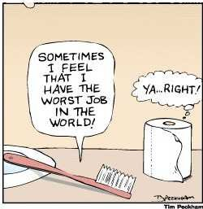
Laugh

Slide 30
Social Connections
Connect with meaningful and uplifting people at least one time per day
Celebrate accomplishments
Gratitude –journal, build into daily routines
Joy – do something you enjoy
Compassion

Slide 31
Using higher brains
To change our thoughts:
CBT
Use the brain to learn the triggers and how do block them or change your thinking before the stress hits.
Learn the triggers so can use higher level stress reduction before in the situation

Slide 32
Preventative Care/Well being
Self care
Have fun
Exercise
Eat Healthy, whole foods
Start day with 3-6 deep breaths
Drink water
Notes:
Others:

Slide 33
Commitment
Pick 3 things you would like to try;
1).
2).
3).
How can you build them into your everyday life without making major changes?
www.robinrose.com
www.getselfhelp.co.uk

