Slide 1
WHY GROUPS FOR ADOLESCENTS?
Peers
Development
Separation-individuation
Connectedness
Attachments
Normal Process

Slide 2
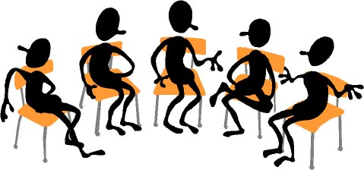
FAMILY THERAPY
System Issues
Intervene in the environment
Support changes of all
Move towards health
Combined with group and family therapy or individual

Slide 3
SKILLS OF THERAPIST
Validation
Work Group Process
Know Yourself
Timing
Stages of Group Development
Crisis of Groups
When to Refer
When to Accept
Confirmation
Boundaries
Conflict Resolution
Empowering Adolescents

Slide 4
ADDITIONAL THERAPISTS SKILLS
Social Media
Wrap Around Concept
Team Work
Avoid Burn Out
Improve Skills
Consultation and Supervision
Good Old Fashion Therapy
CBT
DBT
Psychodynamic
Solution Focused
Art, Dance, Theatre, Poetry
Mediation, Mindfulness
Yoga

Slide 5
ETHICAL ISSUES
Confidentiality
Safety
Drugs and Alcohol
Age
Sex
Boundaries
Cutting and Other Self-Harm
Suicide
Threats, Homicide
Therapist Issues
Parents
Risk Factors
Evidence Base Practices
Legal Issues
Informed Consent
Advocate
Gray Areas

Slide 6
DIVERSITY ISSUES
Culture
Gender
Sexual Identity
Immigrants
Self versus Family
Dealing with Differences
Rap
Flexible

Slide 7
CASE EXAMPLES
A
B
C

Slide 8
AUDIENCE SHARING, CASES, IDEAS, INPUT

Slide 9
Summary, Finish-Up, Questions

Slide 10
THE END

